Slide 1
INDEPENDENT DEFENSE DECK
Style-Aware Adaptation for Language-Conditioned Humanoid Motion Generation
A bridge from paired motion evidence to MoConVQ LoRA pseudo-token targets
Core message
HumanML3D motion is not a MoConVQ token label.
It chooses which teacher-generated token sequence becomes the student target.
Problem
Method
Finding
caption-only distillation leaves paired motion unused
generate candidates, decode them, score against HumanML motion
top-k makes selection real; alignment improves slightly
HumanML3D Motion-Guided Teacher Selection
1 / 16
Notes:
各位老师、同学们好，我汇报的题目是语言驱动人形运动生成的风格感知自适应方法。这个工作的目标是基于humanml3d数据集改进 MoConVQ对形容词不敏感的问题。核心思想是：HumanML3D 的真实动作不直接作为 token 标签，而是作为选择依据，帮助我们从多个 teacher 生成的候选 token 序列中选出更符合配对动作统计特征的训练目标。

Slide 2
TALK STRUCTURE
A standalone story: missing evidence -> bridge -> measured tradeoff
Each section answers one question, so the audience does not need the previous deck.
01
What is missing?
Original LoRA distillation uses captions and teacher tokens, but not paired HumanML3D motion.
02
Why is direct conversion unsafe?
HumanML3D motion features and MoConVQ discrete tokens live in different representation layers.
03
What bridge do I add?
Decode teacher candidates, compare their motion statistics with paired HumanML motion, then select targets.
04
How do I evaluate it?
Separate token learning, old style-direction proxy, and HumanML motion alignment.
05
What should we conclude?
Teacher target selection becomes more data-grounded, but final student evaluation still needs a paired-motion loop.
HumanML3D Motion-Guided Teacher Selection
2 / 16
Notes:
本报告按照五个问题展开。

Slide 3
REPRESENTATION GAP
HumanML3D motion and MoConVQ GPT tokens are different layers
The safest method is selection across layers, not pretending the labels already match.
HumanML3D motion layer
MoConVQ token layer
Student training layer
A sequence of continuous 263-D motion features. Time is discrete by frames, but values are real-valued positions, rotations, and velocities.
A sequence of discrete codebook IDs predicted by the GPT module. Cross-entropy expects integer token labels.
LoRA updates only a small part of the generator, and it learns whichever pseudo-token target we cache.
Unsafe shortcut: continuous HumanML motion -> pretend it is token label
Safe bridge: both sides -> shared feature subset -> select token
Matched features: duration, root speed, path length, velocity, acceleration, jerk, vertical range.
HumanML3D Motion-Guided Teacher Selection
4 / 16
Notes:
这里需要先说明表示层的差异，也是本工作的出发点。HumanML3D motion 是连续动作特征，以矩阵形式存储；MoConVQ 得到的结果则是bvh文件。由于特征不完全匹配，并且机器人的结构也不能保证完全一致，本工作不把 HumanML3D motion 直接转成 token 标签，而是只抽取两边都能计算的共享统计特征子集。

Slide 4
STARTING POINT
The baseline learns from the teacher, but not from paired motion
This is the gap that makes the new deck independent from the previous report.
Available data
Original target
Missing link
HumanML3D gives each row a caption and a paired motion sequence. The motion is not just decoration; it is the strongest evidence of what the caption means.
The teacher generates pseudo-token IDs from the caption. The LoRA student copies those IDs with cross-entropy loss.
The paired HumanML3D motion does not decide which teacher target is chosen, so the target may be valid but weakly data-grounded.
Independent focus: redesign teacher target selection,
not the whole motion generator.
HumanML3D Motion-Guided Teacher Selection
3 / 16
Notes:
研究对象包含三部分。HumanML3D 提供自然语言描述以及与描述配对的动作序列；MoConVQ teacher 能根据文本生成合法的离散 motion token；LoRA student 则用少量可训练参数学习这些 token target。关键问题是，配对动作中包含的真实运动信息，怎样在不破坏 token 空间合法性的前提下参与训练目标构造。

Slide 5
BASELINE FLOW
Caption-only distillation optimizes imitation, not motion-grounded selection
The baseline is useful, but its target source is narrow.
HumanML3D
caption
Frozen
MoConVQ teacher
Pseudo-token
cache
LoRA student
training
Generated
BVH output
What the loss proves
Low cross-entropy means the student copies the cached teacher tokens. It does not by itself prove that the cached tokens are the best match for paired HumanML3D motion.
HumanML3D Motion-Guided Teacher Selection
5 / 16
Notes:
基本蒸馏流程可以概括为：输入humanml的caption（标注），冻结从动作token到bvh文件的转换，而用lora让student学习 MoConVQ teacher的caption到动作token的转换 这个流程可以训练，也能产生可复现的 loss 曲线。但 只用到了humanml的 caption ，没有充分利用数据集。

Slide 6
PROPOSED BRIDGE
Use HumanML3D motion to choose among valid teacher token candidates
The motion never becomes a token label; it selects among tokens that the teacher can already generate.
1
2
3
4
5
6
HumanML row
Teacher samples
Decode candidates
Extract shared features
Select target
Train student
caption + paired motion
multiple token candidates
token -> BVH motion
speed, range, jerk, duration
closest to paired HumanML stats
LoRA learns selected tokens
Key conversion: BVH and HumanML3D are both mapped to the same partial feature set; the selected token then goes back into LoRA training.
HumanML3D Motion-Guided Teacher Selection
6 / 16
Notes:
本方法加入一个 motion-guided selection bridge。对同一个 HumanML3D 样本，teacher 先生成多个 token candidate；每个 candidate 被解码成 BVH motion；然后从 BVH 中提取 duration、root speed、path length、joint velocity、acceleration、jerk 和 vertical range 等可以提取的特征。HumanML3D motion 也被转成同一组统计特征。最后只在这个共享特征子集上计算距离，选择最接近的 token candidate。

Slide 7
LAYER-BY-LAYER CONVERSION
What changes representation, and what stays in the same space?
This table makes the pipeline explicit enough to explain aloud.
Object
Representation layer
Role in method
Conversion
Caption text
Natural language
Condition teacher generation
text stays text
Teacher candidates
Discrete MoConVQ token IDs
Legal pseudo-label candidates
token space
Decoded candidates
BVH -> feature subset
root speed, path length, velocity, jerk
BVH -> stats
HumanML3D paired motion
263-D motion -> same subset
duration, acceleration, vertical range
HumanML -> stats
Selected target
Discrete token IDs
LoRA training label
back to token space
HumanML3D Motion-Guided Teacher Selection
7 / 16
Notes:
这一页进一步明确每一层的转化关系。文本 caption 作为生成条件；teacher candidate 位于离散 token 空间；candidate 解码为 BVH 后，可以计算 root speed、path length、velocity、jerk 等统计特征；HumanML3D 的 263 维 motion feature 不直接对齐 token，而是同样转成 duration、acceleration、vertical range 等统计特征。也就是说，比较发生在共享 feature subset，而不是完整表示空间。

Slide 8
SELECTION SCORE
The score compares only the shared motion-feature subset
Because full representation conversion is unavailable, selection uses robust partial features.
d_HML(x, h) = mean_m | log((x_m + epsilon) / (h_m + epsilon)) |
x_m
h_m
minimum distance
metric from a decoded teacher candidate
matching metric from paired HumanML3D motion
candidate selected as the pseudo-token target
Important: only comparable statistics are matched. This avoids pretending that HumanML3D features can be converted into exact MoConVQ token labels.
HumanML3D Motion-Guided Teacher Selection
8 / 16
Notes:
选择分数采用平均绝对 log-ratio distance。这样可以更好地表明生成的动作与标准动作之间的差异。x_m 表示 BVH candidate 的第 m 个统计特征，h_m 表示 HumanML3D paired motion 转换后的同类统计特征。这里有一个关键限制：由于特征不匹配，我们只匹配可比较的一部分特征，例如速度、路径长度、加速度、jerk 和垂直范围，而不是宣称完成了 HumanML3D 到 MoConVQ token 的完整特征转换。这个设计让比较更稳妥，也更容易解释。

Slide 9
FAILED FIRST ATTEMPT
Deterministic teacher candidates made selection almost meaningless
Before top-k, the selector technically ran but rarely had real alternatives.
Selected candidate counts on 200 samples
199
Diagnosis
If candidate 0 is selected 199 times out of 200, the selection rule cannot visibly change the target cache. The issue is lack of candidate diversity.
1
0
0
Fix: make teacher sampling stochastic with top-k, so the selector gets real choices.
candidate 0
candidate 1
candidate 2
candidate 3
HumanML3D Motion-Guided Teacher Selection
9 / 16
Notes:
在实现中，首先需要保证候选集合真的有差异。若 teacher 采样过于确定，200 个样本中几乎全部都会选择第一个 candidate，此时 selection rule 形式上存在，但无法真正改变 cache。因此，候选生成阶段必须提供足够的多样性，选择机制才有实际意义。

Slide 10
TOP-K FIX
Top-k sampling gives the selector real alternatives
After top-k, 86 of 200 selected targets came from non-first candidates.
Selected candidate counts after top-k
114
86 / 200
selected targets were non-first candidates
31
32
23
Interpretation
This confirms that HumanML motion-distance selection actually changes the cached teacher targets after top-k sampling.
candidate 0
candidate 1
candidate 2
candidate 3
HumanML3D Motion-Guided Teacher Selection
10 / 16
Notes:
采用 top-k stochastic sampling 后，候选分布变得更有区分度。200 个样本中，candidate 0、1、2、3 的选中次数分别为 114、31、32 和 23，也就是说 86 个 selected targets 来自非第一个 candidate。这说明 HumanML motion-distance selector 确实改变了 teacher target cache。

Slide 11
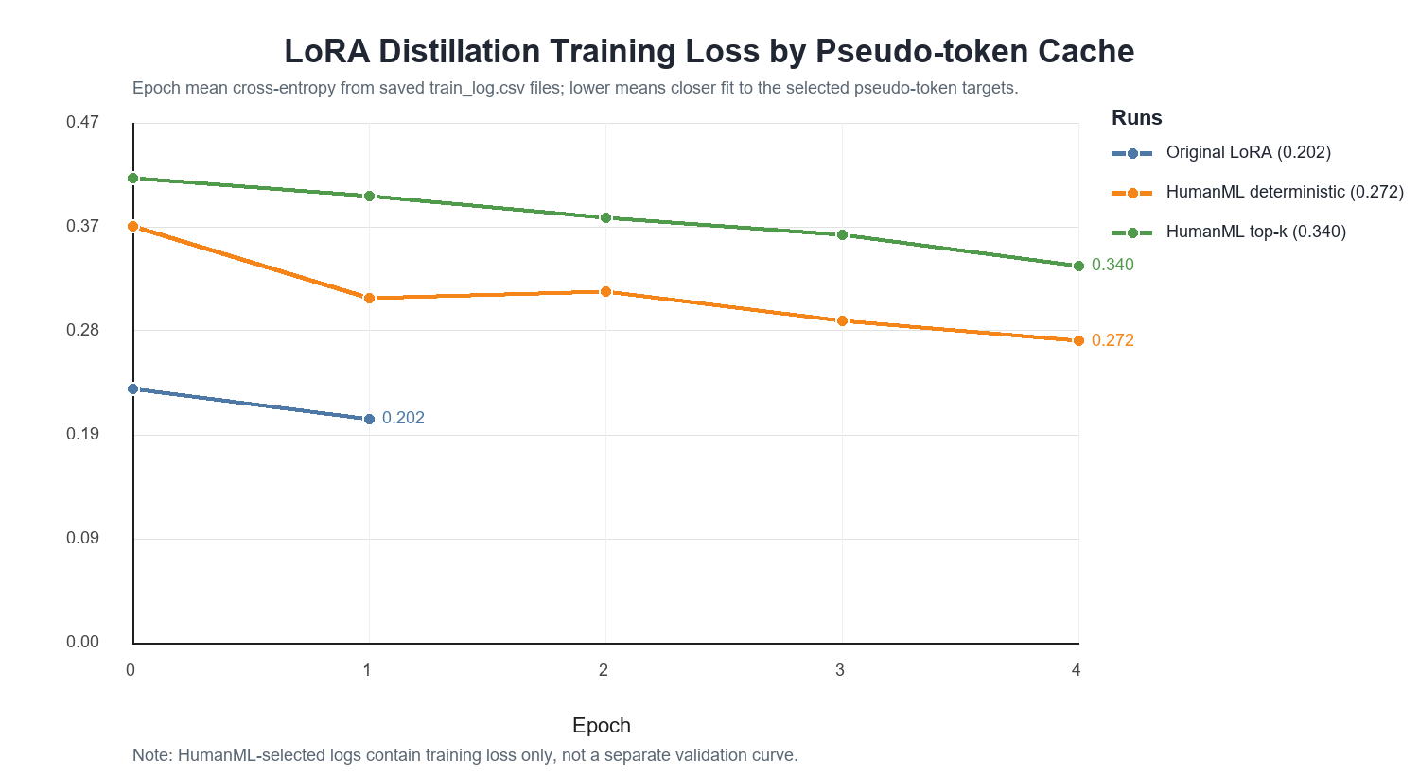
TRAINING BEHAVIOR
The selected cache remains learnable, but top-k targets are harder
Training loss shows imitation is possible; it is not the final motion-quality metric.
Deterministic selected
0.3749 -> 0.2721 over five epochs
Top-k selected
0.4184 -> 0.3396 over five epochs
Reading
Top-k introduces more diverse and harder pseudo-targets.
HumanML3D Motion-Guided Teacher Selection
11 / 16
Notes:
训练损失用于检查 selected cache 是否可学习。top-k selected run 从 0.4184 降到 0.3396。两个曲线都下降，说明 LoRA student 可以学习这些 selected token targets。top-k loss 更高，反映出目标分布更丰富、拟合难度更大。

Slide 12
EVALUATION LENSES
Three metrics answer three different questions
Keeping them separate makes the final tradeoff understandable.
1. Token learning
2. Style-direction proxy
3. HumanML alignment
Measured by training cross-entropy. Question: can the LoRA student imitate the selected teacher pseudo-token sequence?
Measured by direction checks such as lower speed for slow walking or higher vertical range for jumping.
Measured by closeness between selected teacher candidate statistics and paired HumanML3D motion statistics.
The method is designed to improve target selection alignment, not every style-direction check.
HumanML3D Motion-Guided Teacher Selection
12 / 16
Notes:
实验解读需要区分三个视角。第一，training loss 衡量 student 是否学会 selected token。第二，style-direction proxy 衡量生成动作是否符合预设风格方向。第三，HumanML alignment 衡量 selected teacher candidate 是否更接近配对 HumanML3D motion。这三个指标对应不同问题，不能合并成单一结论。

Slide 13
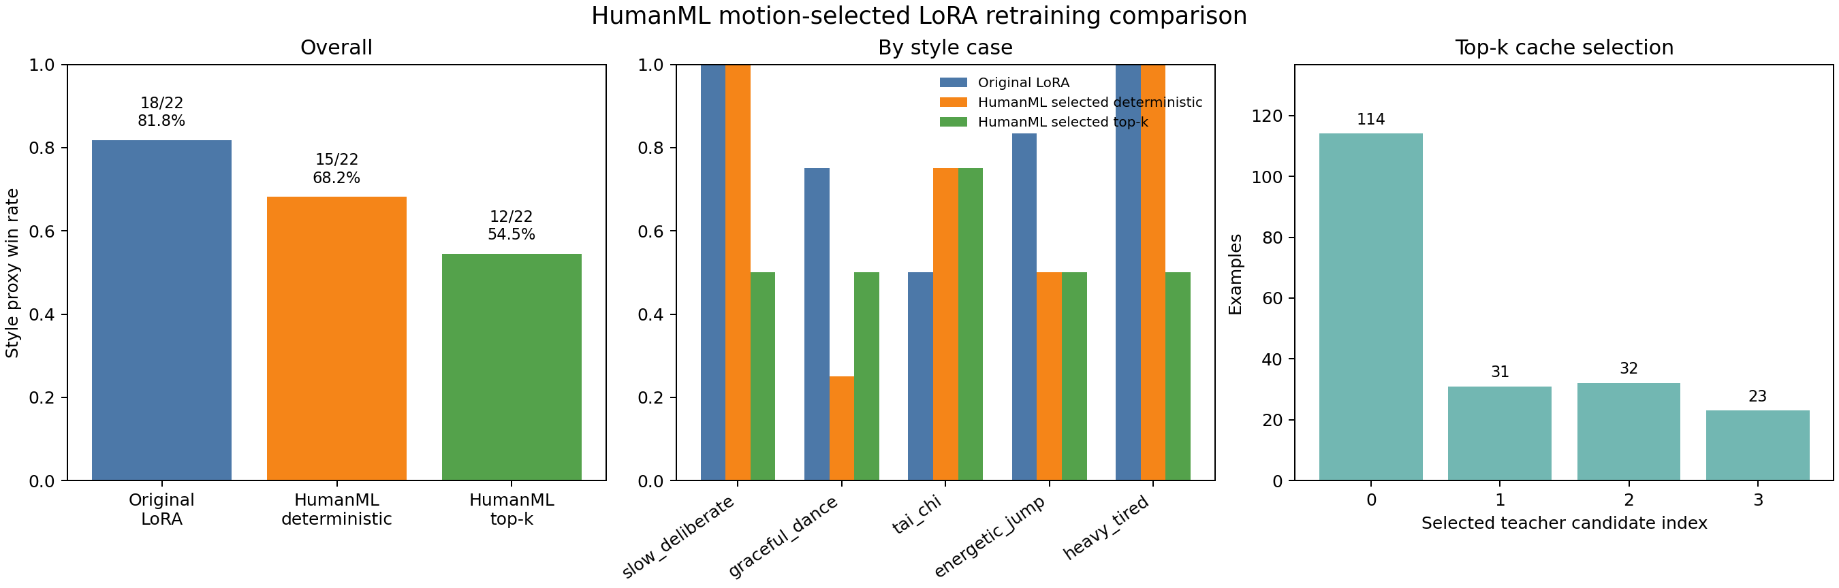
MAIN RESULT
Target alignment improves slightly, while style-direction scores vary
The result supports data-grounded target selection, not finished benchmark improvement.
Style-direction score
18/22 -> 15/22 -> 12/22
Alignment distance
1.9666 -> 1.9419
Alignment score
0.1443 -> 0.1477
HumanML3D Motion-Guided Teacher Selection
13 / 16
Notes:
主要结果显示，top-k selection 让 teacher target alignment 有轻微提升：mean alignment distance 从 1.9666 降到 1.9419，alignment score 从 0.1443 提高到 0.1477。

Slide 14
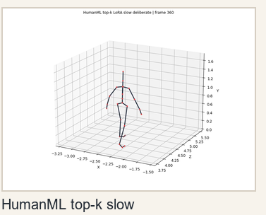
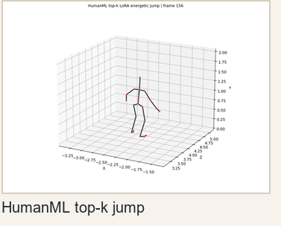
TOP-K VIDEO EXAMPLES
Final qualitative examples from the top-k selected LoRA model
Only the final top-k results are shown here.
Slow deliberate walk
Energetic jump
Caption: A person walks forward slowly and deliberately.
Video: outputs/videos_humanml_alignment/topk_lora_slow.mp4
Caption: A person jumps energetically.
Video: outputs/videos_humanml_alignment/topk_lora_jump.mp4
HumanML3D Motion-Guided Teacher Selection
14 / 16
Notes:
这一页展示最终 top-k selected LoRA 模型的两个 qualitative video examples。左边是 slow deliberate walk，对应 caption 是 A person walks forward slowly and deliberately。右边是 energetic jump，对应 caption 是 A person jumps energetically。可以看到模型确实理解了slow和energetic等形容词的含义。

Slide 15
WHAT THE RESULT MEANS
The contribution is a bridge and a diagnosis, not a finished evaluator
This framing keeps the defense honest and focused.
What improved
What remains limited
What comes next
Candidate selection became meaningful after top-k. HumanML paired motion now influences which teacher token sequence enters the LoRA cache.
The style-direction proxy does not improve together with HumanML alignment. The two metrics measure different objectives.
Close the loop by evaluating generated student BVHs against paired HumanML3D motion IDs, not only against teacher candidates.
Defense sentence to say aloud:
The method improves how teacher targets are chosen; it does not yet prove that the final student is better under every style metric.
HumanML3D Motion-Guided Teacher Selection
15 / 16
Notes:
因此，本工作的提出数据驱动的 target selection bridge。它证明 HumanML3D motion 可以作为共享特征子集下参与 MoConVQ LoRA 蒸馏目标构造。

Slide 16
CONCLUSION
From caption-only distillation to motion-grounded target selection
The most important idea is the bridge between representation layers.
HumanML3D motion is not used as a fake token label. It is used as evidence to select among valid MoConVQ teacher tokens.
1
Representation gap identified
continuous HumanML motion cannot directly supervise discrete MoConVQ GPT tokens
2
Bridge implemented
teacher candidates are decoded and compared against paired HumanML motion statistics
3
Top-k fix verified
86/200 selected targets come from non-first candidates after stochastic sampling
4
Honest result
alignment improves slightly; paired student evaluation remains future work
HumanML3D Motion-Guided Teacher Selection
16 / 16
Notes:
最后总结一下。本报告识别了 HumanML3D 连续动作特征与 MoConVQ 离散 token 之间的表示差异，并提出用 decoded BVH statistics 和 HumanML3D motion statistics 连接两者。由于完整特征转换不可用，方法只匹配 duration、root speed、path length、velocity、acceleration、jerk、vertical range 等共享特征。top-k sampling 提供候选多样性，HumanML distance 完成 target selection。后续工作需要进一步评估 student 生成 BVH 与配对 HumanML3D motion 的直接对齐程度。我的汇报结束，谢谢大家。

